Slide 1
Design System & Prototyping

Slide 2
Design System & Protoyping
Summary
Introduction to Design System
Conducting a Design System Project
Tips and Tricks
Different types of UI
Ressources
Additional Reading

Slide 3
Summary
As we wrap up this module, you will take a step back and recognize how far you will have come.
In the upcoming Design Systems sessions, you will learn how to create consistency across a product by building reusable components, setting clear visual guidelines, and maintaining design coherence. These systems won’t just be about aesthetics — they will support smoother collaboration and more efficient design workflows.
In the Prototyping part of the course, you will explore how to bring your ideas to life. From wireframes to high-fidelity prototypes, you will practice how to test and validate your designs before they ever reach development.
You will learn how to communicate user flows, gather feedback, and iterate quickly.
Together, these skills will become powerful tools to help you design smarter, communicate better, and build products users truly value.
Keep practicing, keep testing — and always design with purpose!

Slide 4
Introduction to Design System
Notes:
📌 Objective: Introduction to Design Systems and Prototyping in UX/UI. 🔹 Key Takeaways:
A design system is a structured set of guidelines, best practices, and reusable UI components.
It ensures consistency, reduces redundancy, and creates a shared language for design and development teams.
A well-implemented design system improves collaboration and efficiency.

Slide 5
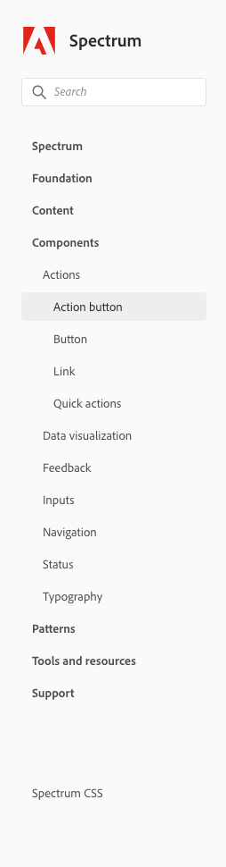
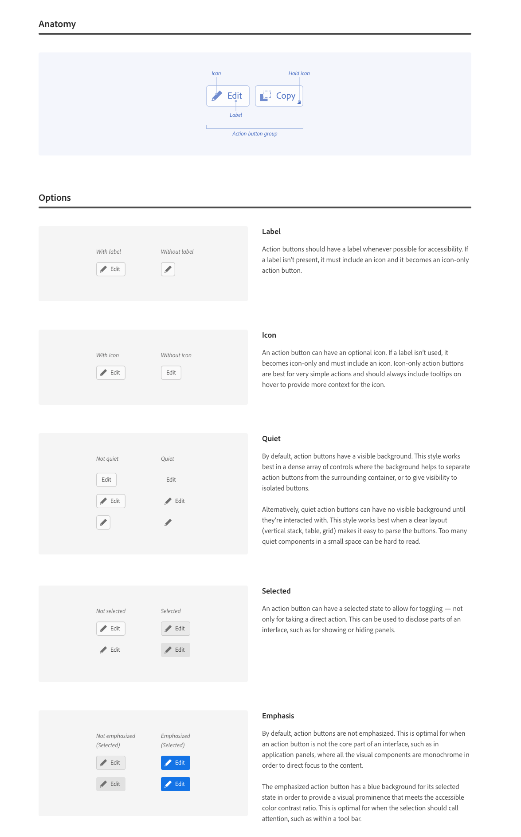
What is a Design System ?
The design system translates into a set of rules, best practices, reusable elements and resources that are made available to the different teams. We can see the design system as a large toolbox common to all teams that would bring ease and consistency when building interfaces.
A design system is a set of standards to manage design at scale by reducing redundancy while creating a shared language and visual consistency across different pages and channels.
Source: www.adobe.com
Notes:
📌 Objective: Define what a design system is and its core components. 🔹 Key Takeaways:
A design system is a toolbox for product teams, providing:
Standardized components (buttons, inputs, typography).
Guidelines for branding, UX, accessibility, and development.
Patterns for consistent user experiences.
It facilitates cross-team collaboration and scales design efficiently.
🔗 Examples:
Polaris (Shopify)
Material Design (Google)

Slide 6
The benefits of the design system
Consistency of the user experience
A reinforced identity on all media and platforms
Save time and money
Centralized maintenance
Simplified communication within the team (see slide n° 10)
Encourages co-creation
A system validated by the various experts (UX / UI / PO / Tech / Accessibility)
It's a gain in terms of Consistency, Time and Money
Notes:
📌 Objective: Highlight the advantages of using a design system. 🔹 Key Benefits: ✅ Consistency across products and platforms. ✅ Time and cost savings (reducing redundant work). ✅ Faster development cycles with reusable components. ✅ Centralized maintenance, making updates easier. ✅ Improved communication between designers, developers, and stakeholders.
🔗 Additional Reading:
Design System ROI Calculator https://www.designsystems.com/

Slide 7
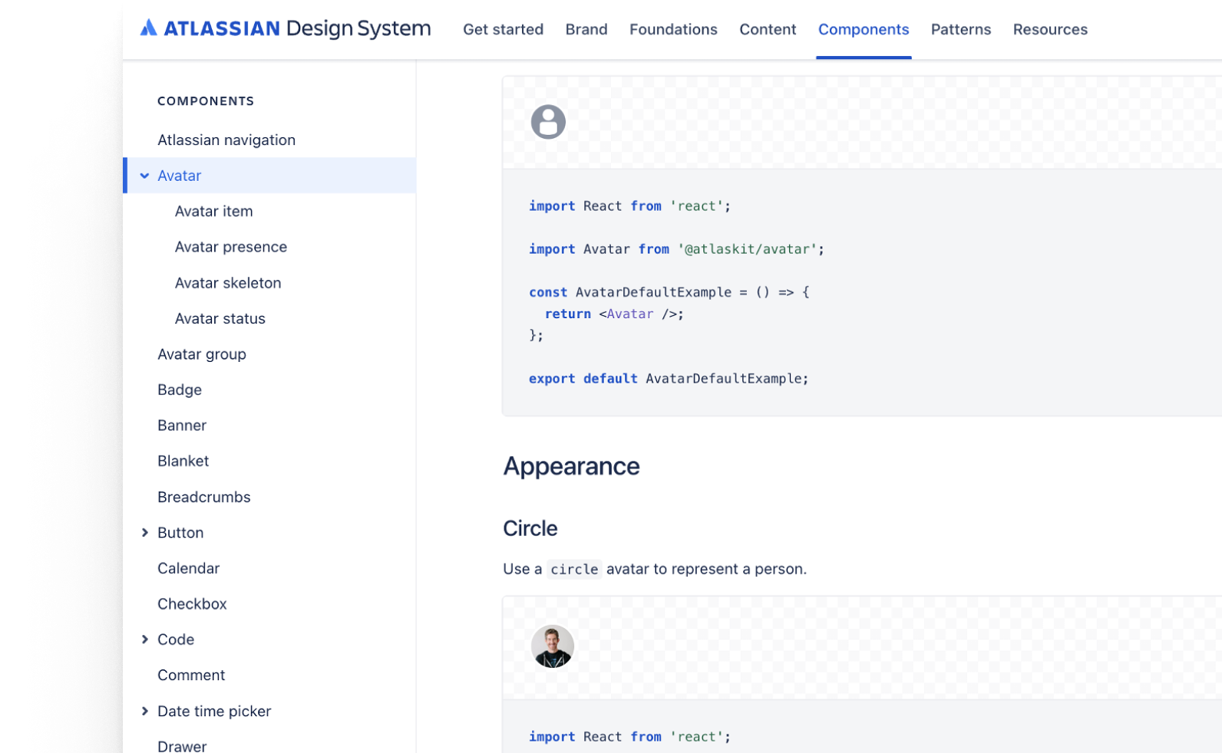
Examples
Atlassian
https://atlassian.design/
Rules of use, design, code, editorial
Components
Patterns
Brand
Foundations
Thrilled
Source: https://atlassian.design/
Notes:
📌 Objective: Showcase real-world design systems. 🔹 Key Takeaways:
Large companies maintain public design systems for scalability and efficiency.
Example systems:
Atlassian – Focuses on foundations, components, design tokens.
IBM Carbon – Emphasizes accessibility, development, and data visualization.
Shopify Polaris – Built for e-commerce experiences.
Design tokens are scalable variables for colors, typography, and spacing.
🔗 Additional reading:
https://atlassian.design/

Slide 8
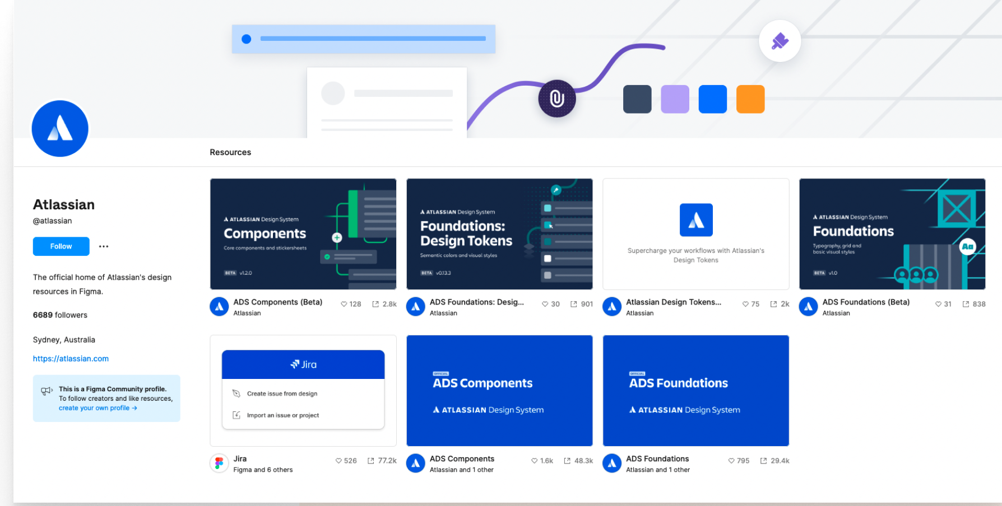
Examples
Atlassian
Foundations
Components
Design tokens
https://www.figma.com/@atlassian
Source: https://www.figma.com/@atlassian

Slide 9
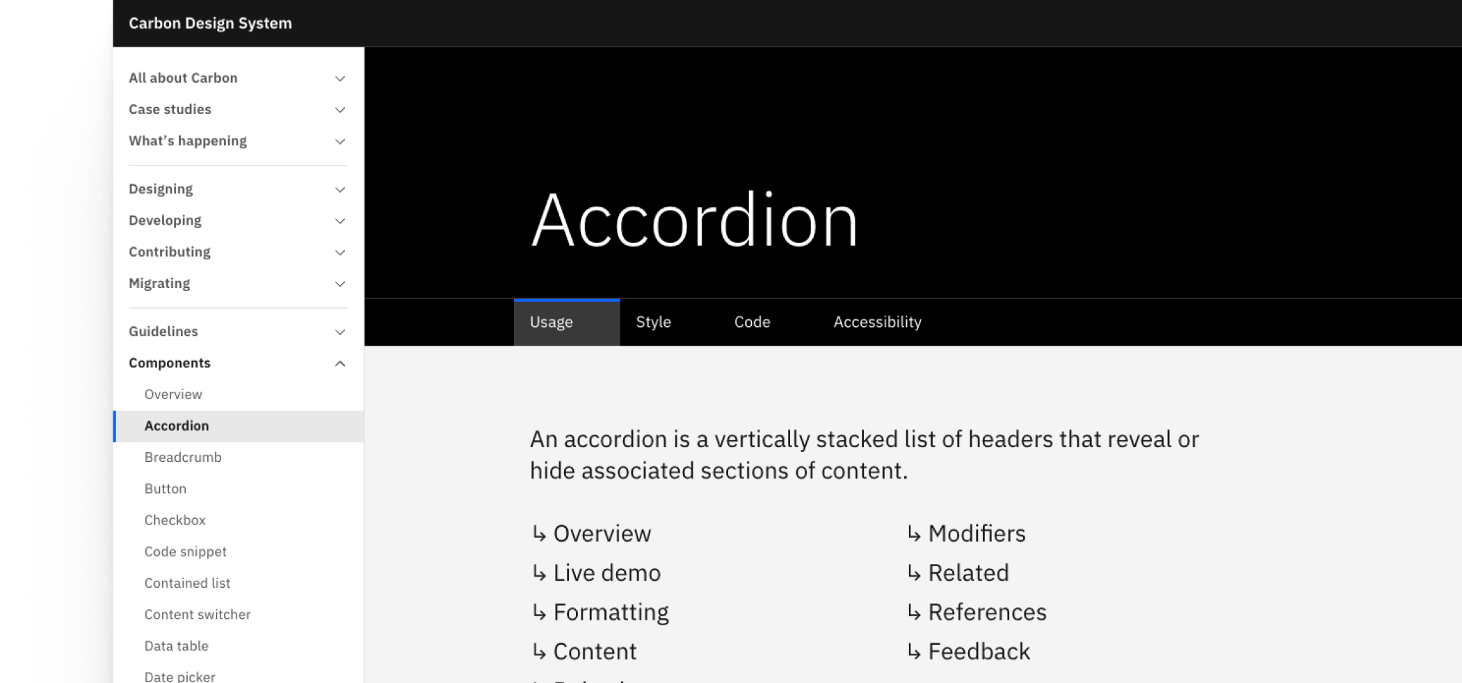
Examples
Carbon
Rules of use, design, code, accessibility
Designing
Developing
Contributing
Migrating
Guidelines
Components
Patterns
Community assets
Data visualization
Source: https://www.figma.com/@ibmorg

Slide 10
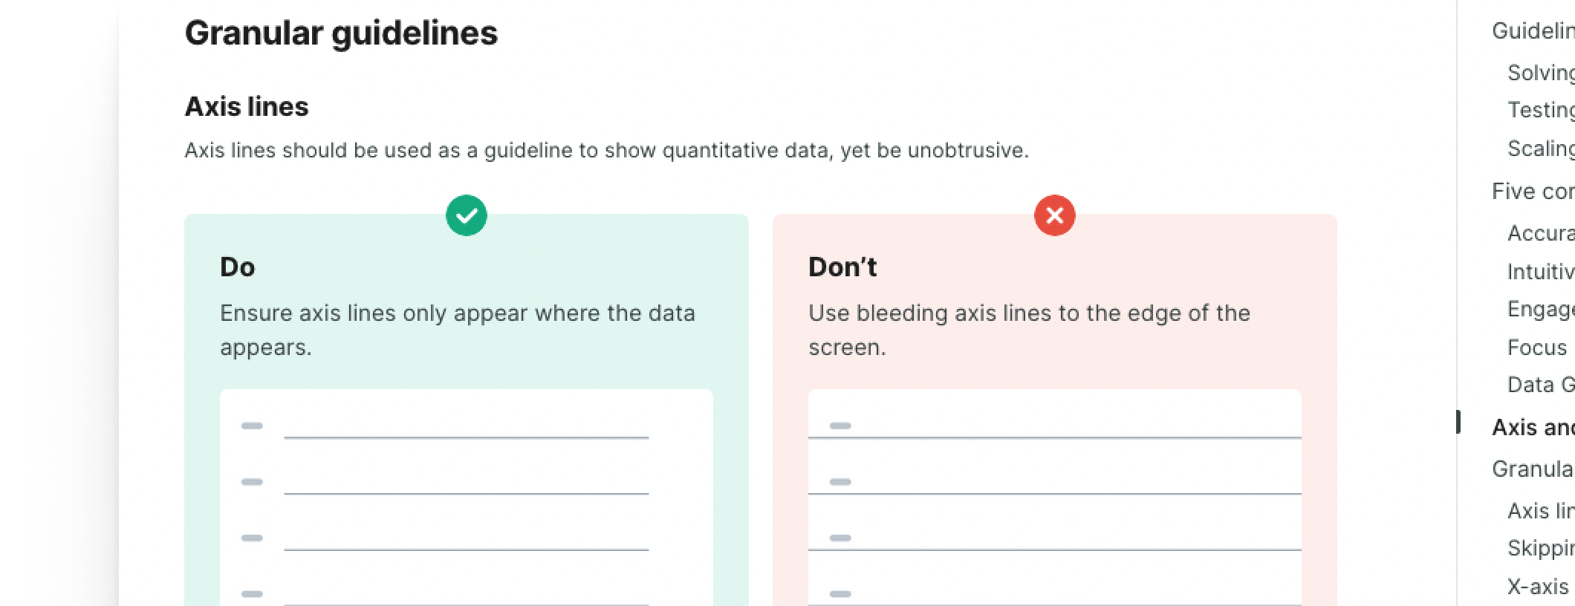
Examples
Polaris (Shopify)
https://polaris.shopify.com/
Source: https://polaris.shopify.com/

Slide 11
Some principles of a design system
The design system is never finished, it is built and evolves with the product. To be successful, you have to start small.
The design system is not just about designers, it is a full-fledged product that needs a team, referents, a vision and rules.
Everyone's collaboration is the key point that defines a good design system.
Notes:
📌 Objective: Explain the core principles behind a design system. 🔹 Key Takeaways:
A design system is never truly finished; it evolves with the product.
It requires dedicated ownership, including UX, UI, developers, and product managers.
Collaboration and governance are essential for long-term adoption and consistency.
🔗 Recommended Reading:
Atomic Design by Brad Frost https://bradfrost.com/blog/post/atomic-web-design/

Slide 12
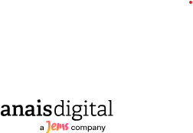
Roles & Responsibilities
Stakeholders
Product team
(UX, UI and Dev)
Core team
It sets up the system and its vision.
It validates what enters and leaves the system.
She actively involves others.
They are the first users of the system.
They centralize daily, with the help of the core team, their knowledge, common assets and tools.
If they are also contributors, they must be aware of the priorities of each team and have a good overview.
They all share a common philosophy, viewpoints and principles related to the system.
They monitor and educate everyone on the objectives and progress related to the design system.
They bring new perspectives and different points of view.
They support various ideas and initiatives.
They monitor and educate everyone on the objectives and progress related to the design system.
They bring new perspectives and different points of view.
They support various ideas and initiatives.
Customers and end users
Notes:
📌 Objective: Identify key stakeholders in a design system. 🔹 Key Roles: 👤 Core Team: Defines the system, validates new components, maintains consistency. 👥 Product Team: First adopters of the system, contribute to improvements. 👨‍💻 Developers & Designers: Implement, iterate, and refine components. 📢 Stakeholders (PMs, Accessibility Experts): Ensure system adoption across teams.
🔹 Why is this important?
Having clear ownership and processes ensures scalability and consistency.

Slide 13
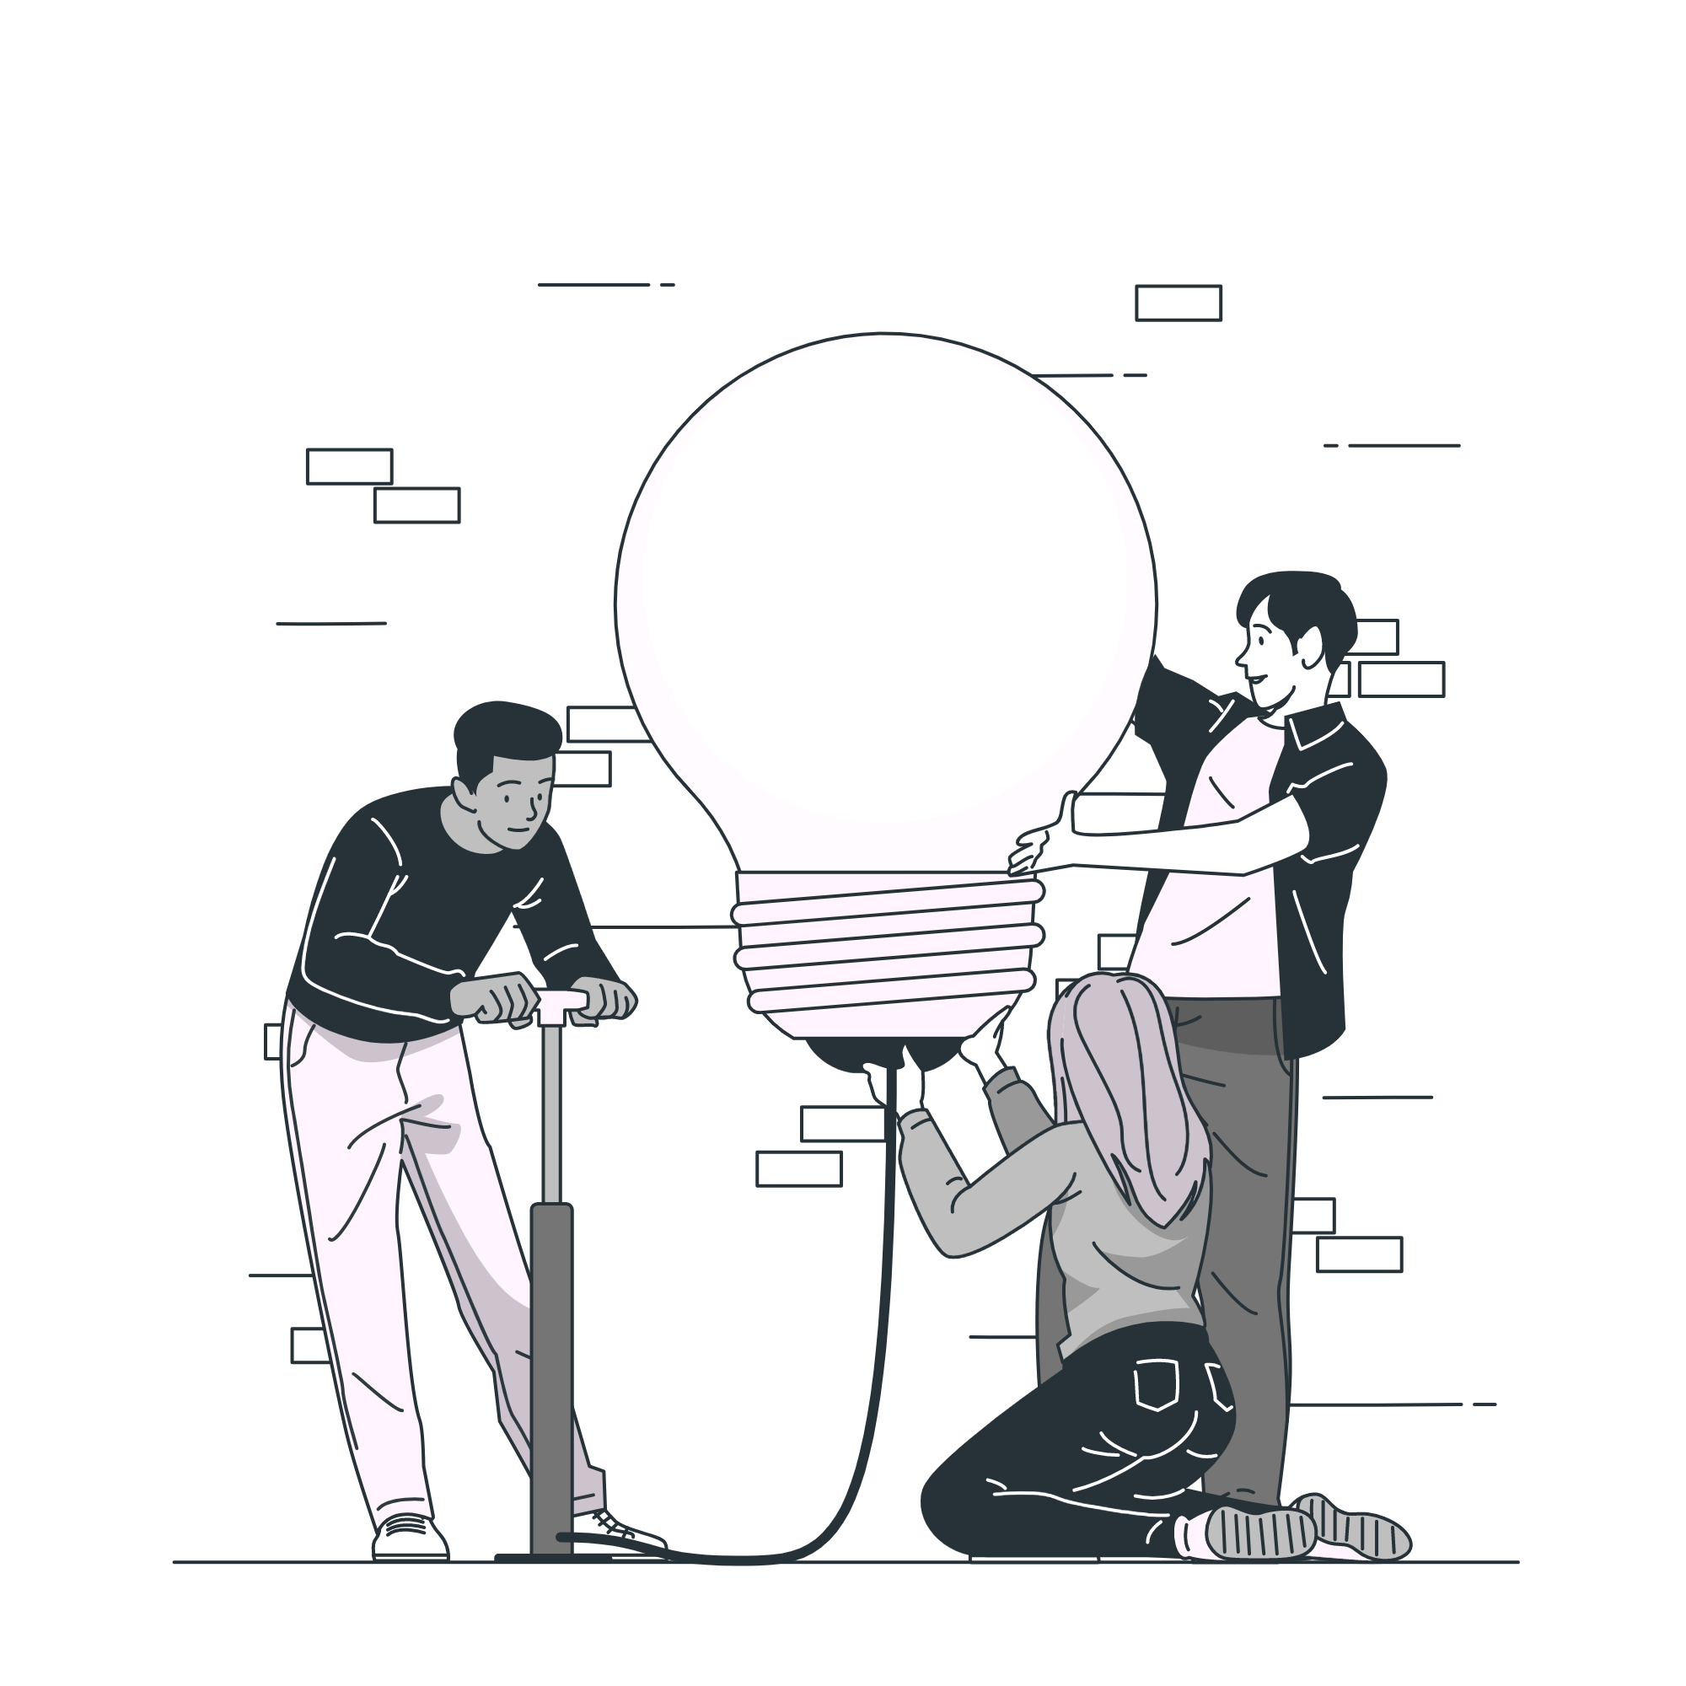
Who should be part of your core team?
Roles? | Why?
Product Owner | Keeping a product vision
Developers | Validate technical feasibility
UX Researcher | Maintain consistency with the results of user studies
UX Designer | Producing what works through multiple feedbacks
Accessibility expert | Ensuring compliance with accessibility criteria
Communication Team | Guarantor of the corporate branding

Slide 14
Conducting a Design System project
Notes:
📌 Objective: Outline the process of creating a design system. 🔹 Step-by-Step Approach: 1️⃣ Inventory of existing components & branding assets 2️⃣ Definition of experience principles & alignment across teams 3️⃣ Prioritization of components based on value & impact 4️⃣ Implementation & documentation 5️⃣ Measuring success with KPIs
🔗 Helpful Resources:
Interface Inventory Guide by Brad Frost https://bradfrost.com/blog/post/interface-inventory/

Slide 15
Alignment
Inventory
To have an overview of the patterns (components, recurring functionalities in your system) based on existing product and chosen baseline framework.
To collect all branding assets (recurring branding elements, icons, colors...) most used in the world of products and then prioritize them.
Needed to organize workshops with the different teams

Slide 16
Alignment
Experience principles
To have an overview of the patterns (components, recurring functionalities in your system) based on existing product and chosen baseline framework.
To collect all branding assets (recurring branding elements, icons, colors...) most used in the world of products and then prioritize them.
Needed to organize workshops with the different teams

Slide 17
Alignment
Roles & process
Identify and understand each person's roles precisely and their associated tasks.
When we talk about design systems, we often distinguish between 4 types of roles: "sponsors", "guarantors", “contributors” and "consumers".
The roles will be distributed following the chosen implementation process.
Result : we know how you want to work & manage you design system

Slide 18
Alignment
Prioritization of components
Prioritize components by value (most frequent and easy to develop) in order to get the product backlog and a prioritization of the elements to be documented in the design system.
We will either re-use & transform some existing components or build new ones essential to compose your design system MVP (Minimum Viable Product).

Slide 19
Alignment
How do you measure your success ?
Define the main objectives of the design system, whether internal or external, and then associate them with precise measurement indicators.
Define the key success factors of your design system is paramount. It is thanks to this that you will then be able to measure the value and success of the system with the right indicators.

Slide 20
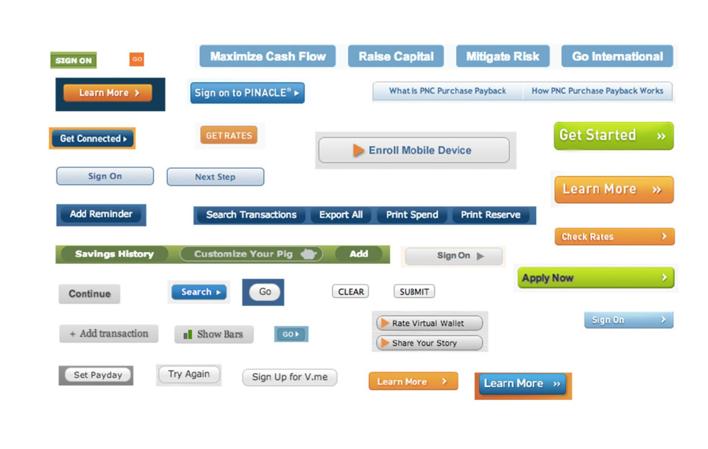
2. Inventory and file structure
Inventory
Make an exhaustive list of interface elements
Deconstruct current/future interfaces into smaller pieces
Check the consistency of interface elements / styles
Source: https://bradfrost.com/blog/post/interface-inventory/

Slide 21
2. Inventory and file structure
Prepare a blank file (in any tool to paste screenshots into)
By screen/feature, take screenshots of interface elements
Categorize screenshots (eg: buttons, form elements, headers, ...)
https://bradfrost.com/blog/post/interface-inventory/

Slide 22
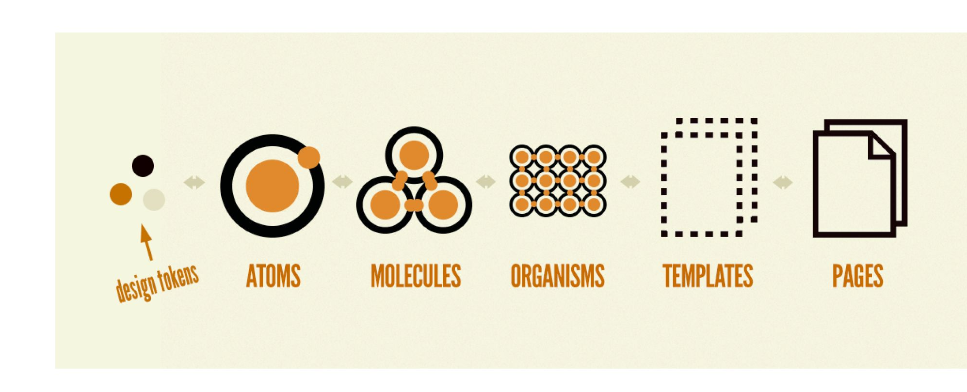
2. Inventory and file structure
Breaking down interfaces
Source: https://bradfrost.com/blog/post/atomic-web-design/

Slide 23
EXERCISE
Make the inventory of a website homepage
Notes:
Students are free to chose a homepage

Slide 24
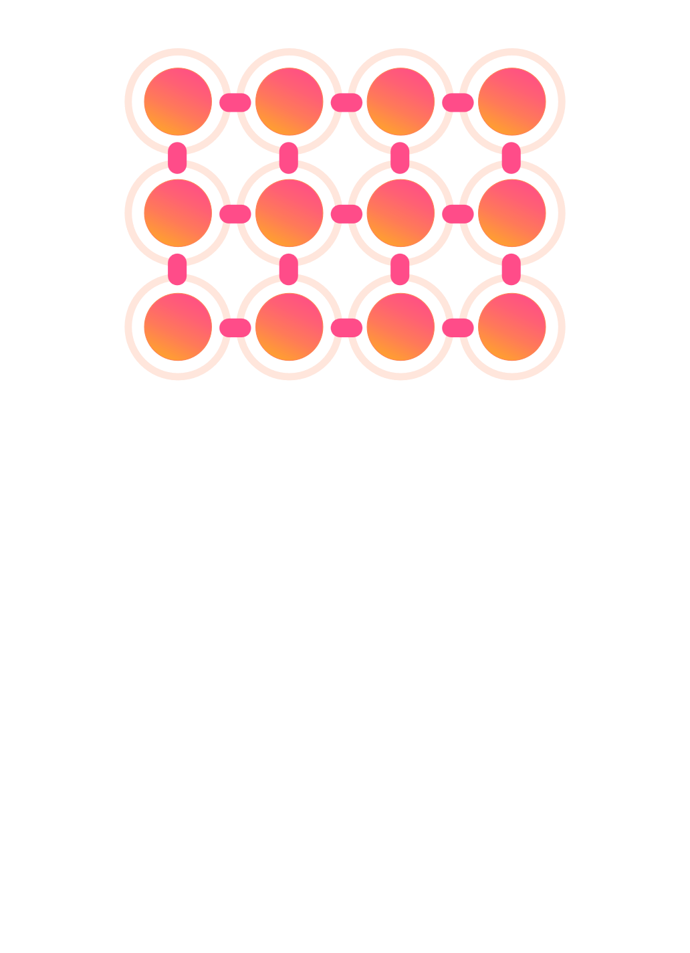
Example: zalando
Organizations
Modules / Features
Source: https://www.zalando.be/?_rfl=nl

Slide 25
Example: zalando
Organizations
Modules / Features
Source: https://www.zalando.be/?_rfl=nl

Slide 26
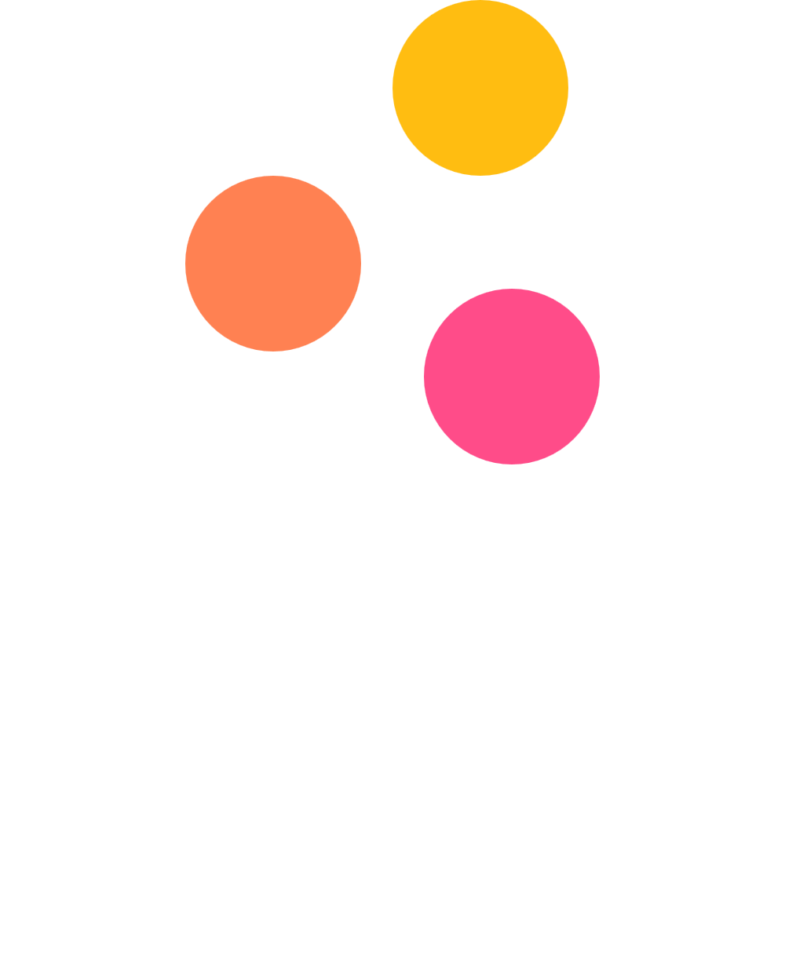

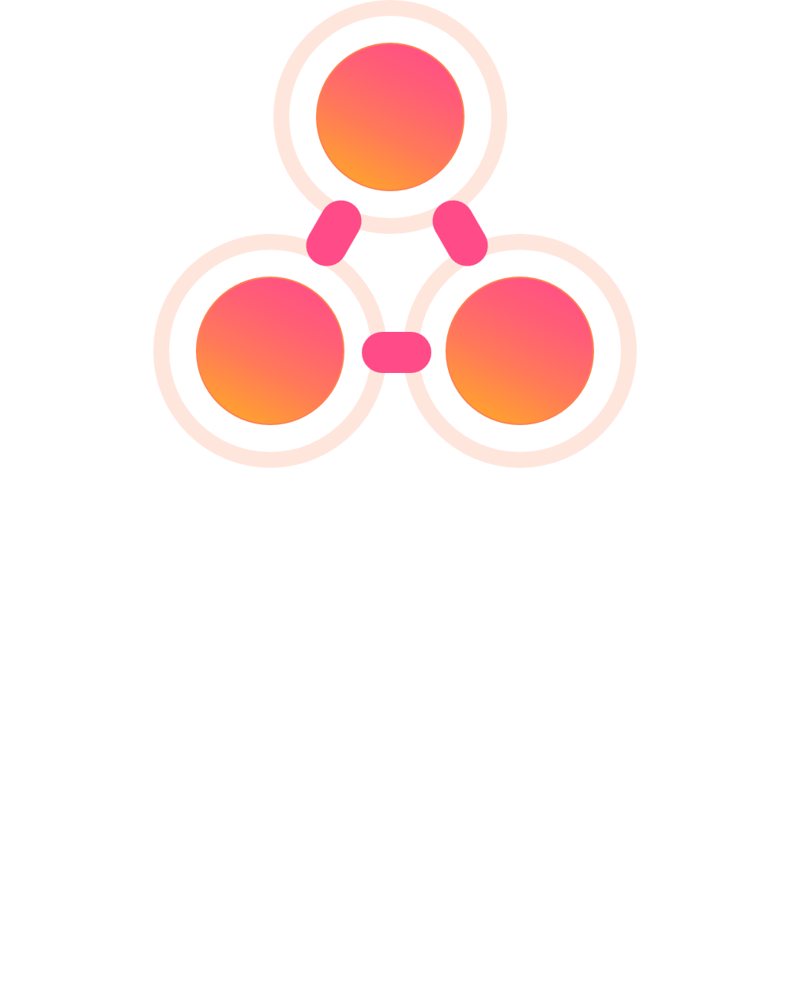




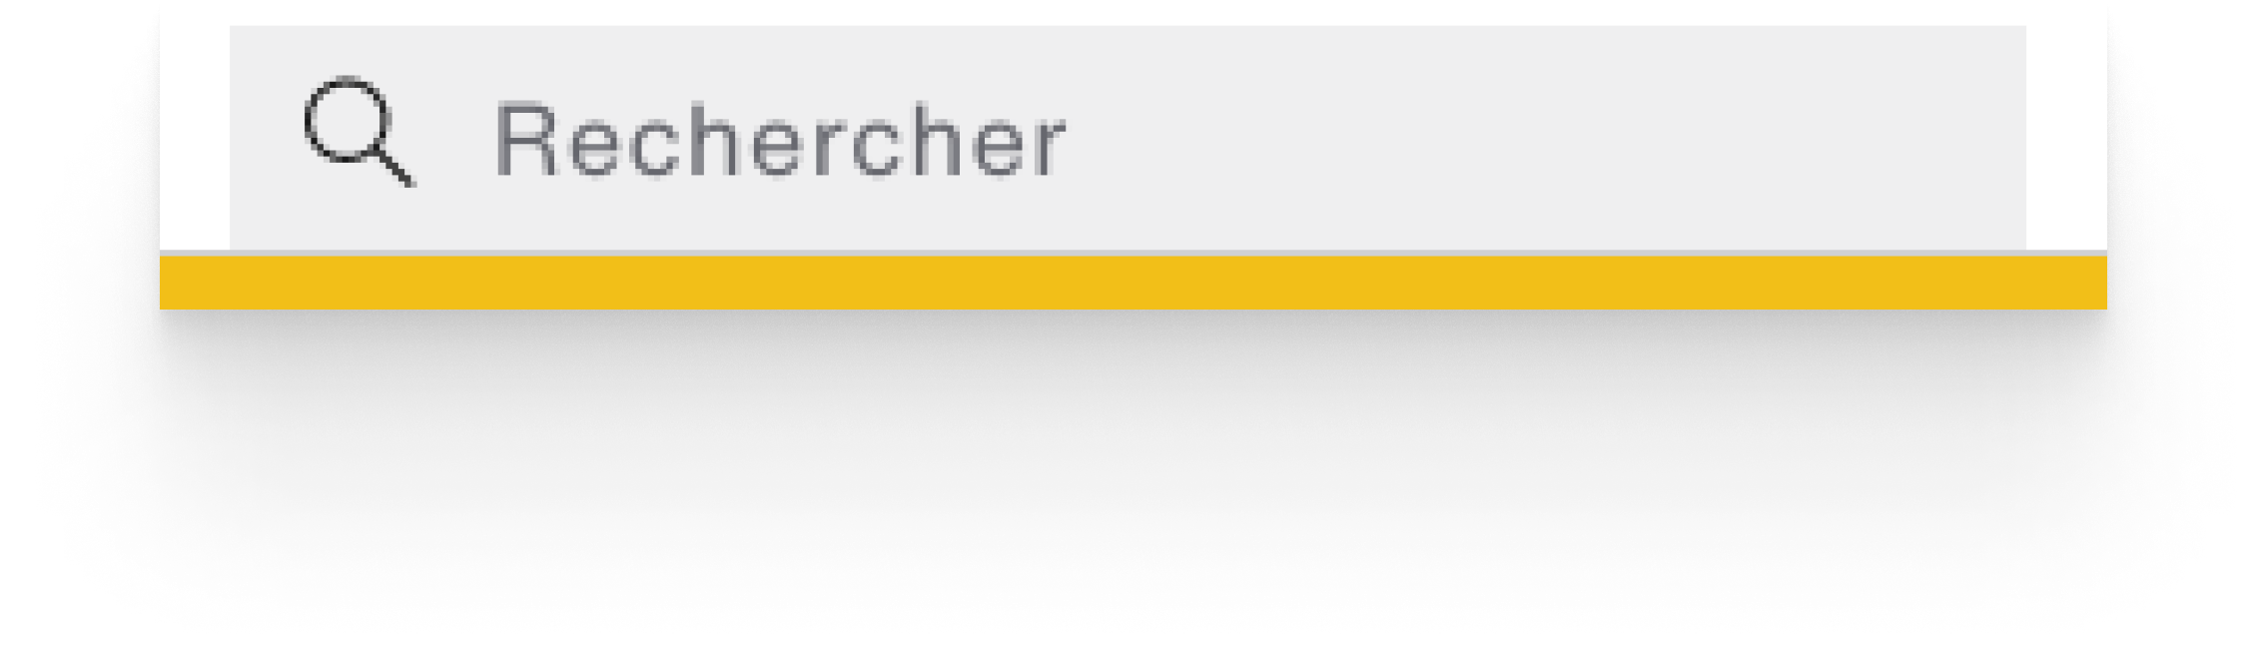
Example: zalando
Ions
Atoms
Molecules
Design tokens
Components
Patterns
Icon
Text
Colors
Source: https://www.zalando.be/?_rfl=nl

Slide 27
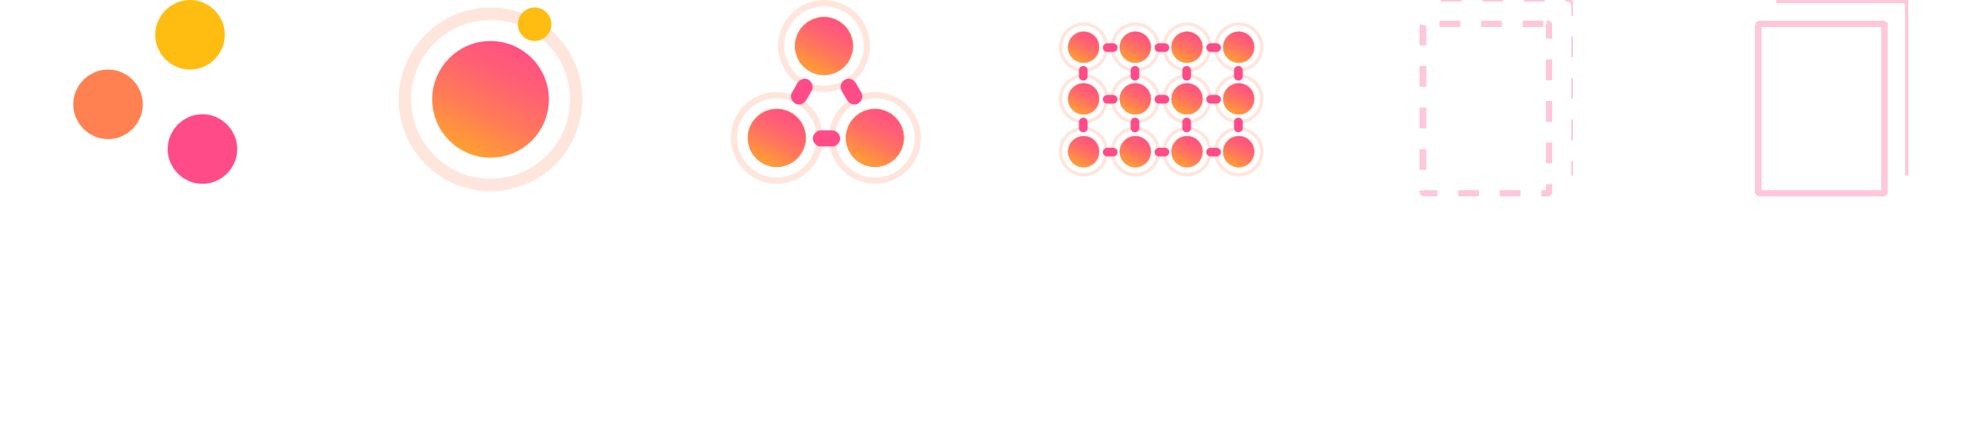
Hierarchy
Ions
Atoms
Molecules
Organizations
Templates
Pages / Products
Design tokens
Components
Patterns
Modules Features

Slide 28
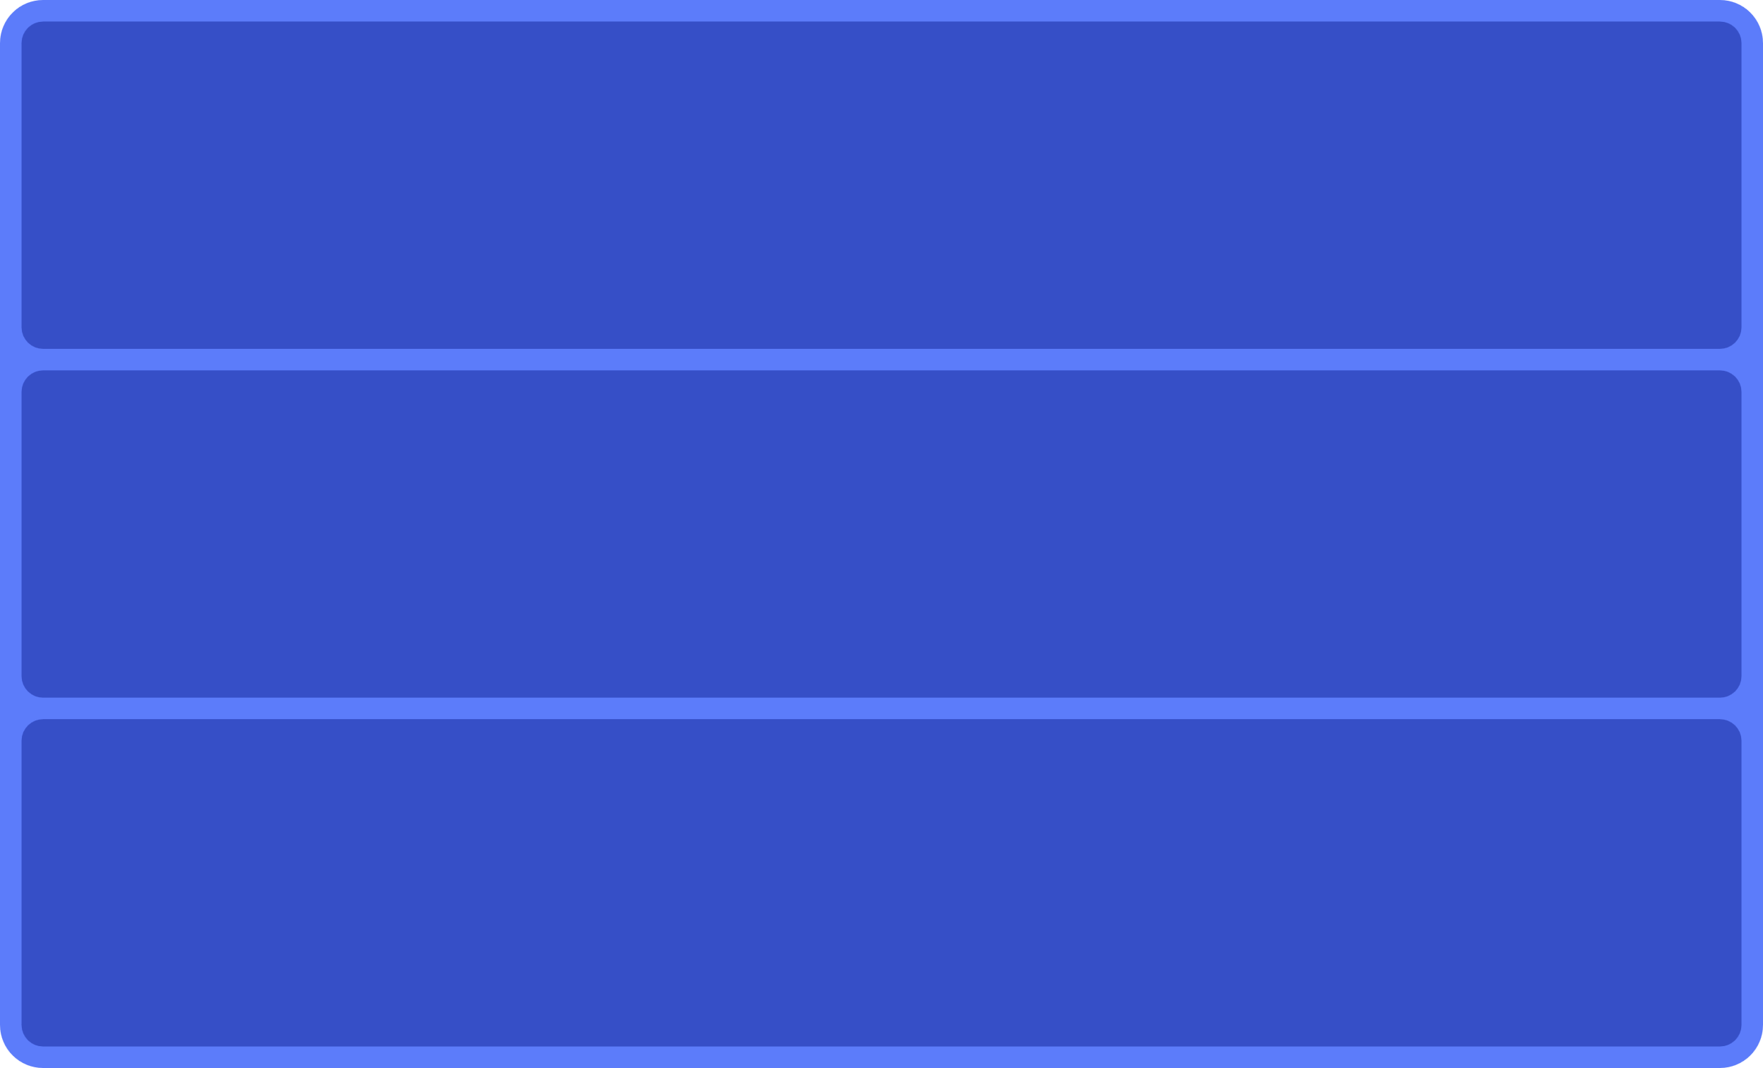
File structure of your DS
Styles (texts, colors, effects)
Ions
Components
Atoms, molecules
Complex components / modules
Organizations

Slide 29
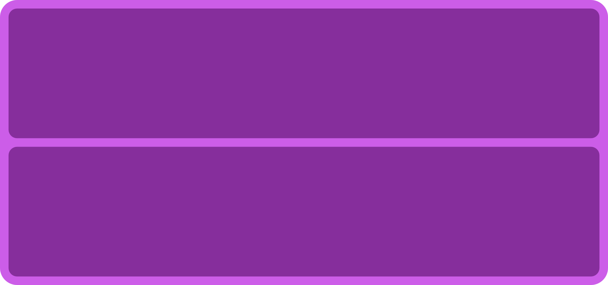

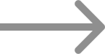
File structure of your DS
Styles (texts, colors, effects)
Components
Styles (texts, colors, effects)
Atoms, molecules
Ions
Complex components / modules
Organizations

Slide 30



File structure of your DS
Components
Atoms, molecules
Light Styles
Ions
Complex components / modules
Swap bookstores
Organizations
Dark Styles
Ions

Slide 31


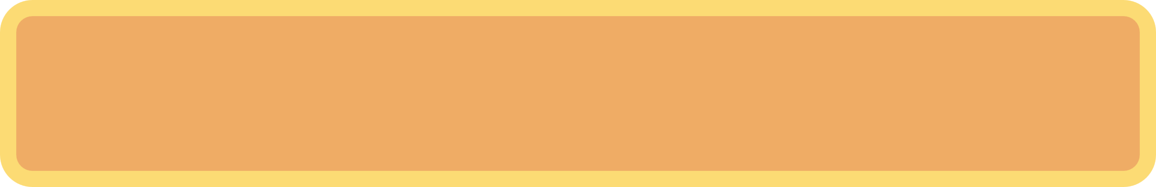






File structure of your DS
Component
Component
Component
Styles (texts, colors, effects)
Component
Ions
Component
Component

Slide 32
File structure of your DS
1 file only: Ease of navigation in Figma
Only one file to watch
all in one place
Small to medium project
1 style file + 1 component file
Possibility of “swapping libraries” of styles (branding / light & dark mode etc.)
Clarity of separate files
Small to medium project
1 style file + 1 file per component
Less risk when pushing for changes
Focus on one thing at a time
Easier for versioning
Best performance
Large project
Notes:
📌 Objective: Best practices for organizing a design system in Figma. 🔹 Common Structures:
Single File: For small projects, everything in one place.
Style + Component Files: Separate files for scalability.
Library System: Swap styles (e.g., light/dark mode, branding variations).
🔹 Why is this important?
Helps reduce complexity and increase maintainability.

Slide 33
Nomenclature
"There are only two hard things in Computer Science: cache invalidation and naming things."
Phil Karlton
Notes:
📌 Objective: Define best practices for naming components and maintaining documentation. 🔹 Key Guidelines: ✅ Use semantic names instead of generic names (e.g., Primary Button instead of Button 1). ✅ Group elements by functionality rather than style. ✅ Maintain comprehensive documentation for developers and designers.
🔗 Naming & Documentation Resources: https://designsystemchecklist.com/

Slide 34
Examples / Links
Decathlon https://www.decathlon.be/nl/splashpage/
Gov.uk https://www.gov.uk/
Material Design https://m3.material.io/
There is a Figma plugin to generate a palette based on their principles
Proxyclick
Luis on color tokens https://youtu.be/uiCGvhI7Vwo?si=yrelRecf0K1BrTh-
THE Druids colors which (subjectively) offer a good balance

Slide 35
Icons
Not necessarily relevant to put all the icons in variants
Some have more meaning to be than others, to change them more easily (example: chevron up / down)
To facilitate component swap, ensure that component layers are identical (except for one exception: 1 vector layer named the same for each icon)
Ability to provide icon size variations for stricter usage Possible to manage it with a “base component” but requires more maintenance anyway.

Slide 36
Components
Too many variants/properties can harm the usability of the DS
They can be more difficult to use/discover
Example: all inputs in variants would not allow to quickly search and use an input date
Separate by use Example: if a badge with icon is always used in case A and the one without icon in case B, these are 2 different components
Fewer properties = more consistency
“Base components” can be useful for managing large numbers of variants/components
Use “unpublished components” to facilitate maintenance without cluttering user choices
Component discoverability: Luis - “Is this a component?”
Example of tabs that may be too complex ?

Slide 37
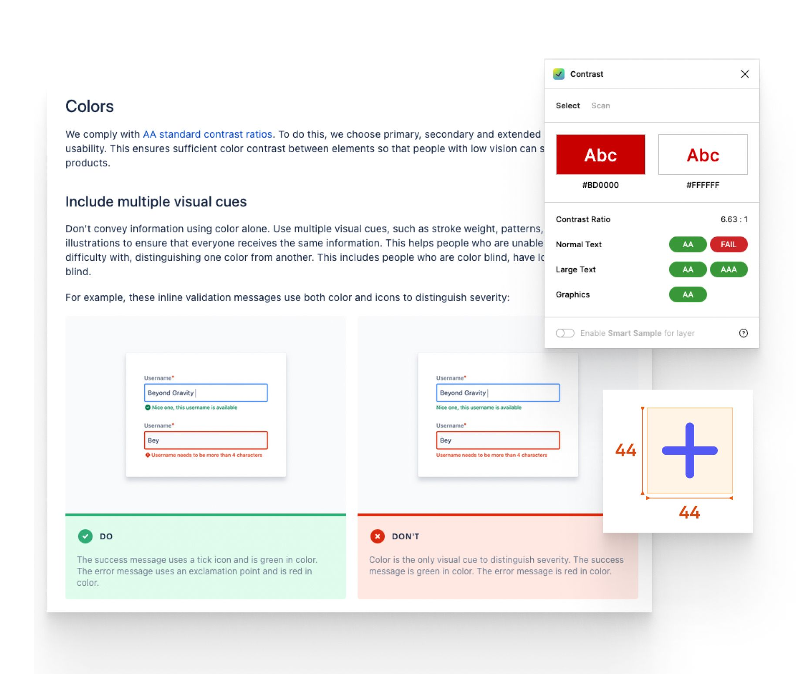
Documentation: accessibility
Like all other concepts, the Design System also allows us to centralize (in part) accessibility.
Color contrasts
Target Size
Text size
Don't rely on colours alone
Specific behaviors
Tab-index
Increased contrast mode
...

Slide 38

Documentation: accessibility
Plugins
Contrast
Check Contrasts - Be careful, not as reliable as using “true contrast checkers”.
Adee
Accessibility toolbox (contrasts, target size, color blindness simulation, ...)

Slide 39
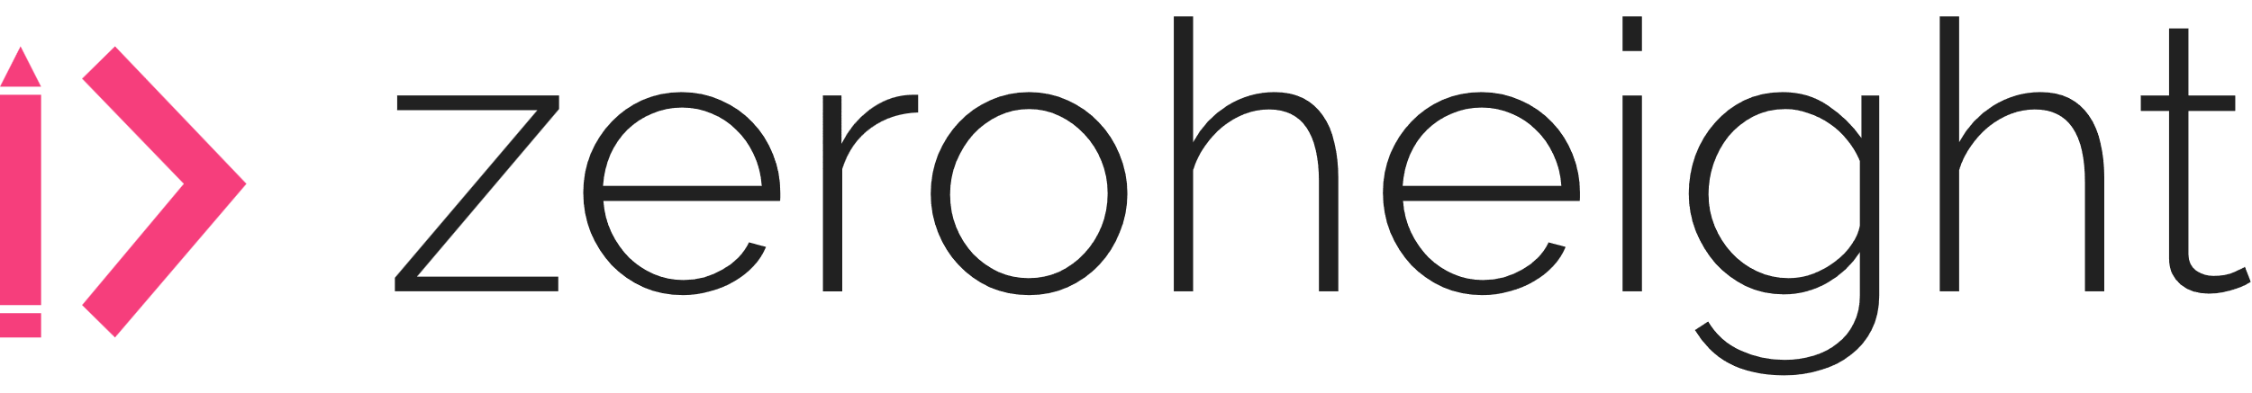

Documentation Tool
Source: https://zeroheight.com/login
Your own platform?
Source: https://storybook.js.org/

Slide 40
Tips and tricks

Slide 41
Tips and tricks: styles
Don't create too many unnecessary styles
If styles exist but are not Never used, they only clutter the DS
Choosing a consistent nomenclature
To make them easy to find and use
Use descriptions to make usage easier
Group them in a coherent manner

Slide 42
Tips and tricks: nomenclature
It all depends on the context, who is using the DS and how.
If it is not necessary, do not complicate
Getting closer to the code
Use human-readable names
Use semantic (rather than generic) names
Grouping together like with like
Use descriptions to complete what cannot be said in the name
(see point on documentation)

Slide 43
Tips and tricks : changes
Make a change
Tip: place an instance of the component with different overrides next to the main in order to see live if things break.
Push a change(s)
By selecting the relevant component
Via asset / library
Comment on your “push”
Accept a change(s)
Accept all/some components
Verify that the changes are safe

Slide 44
Tips and tricks : annotation
Use descriptions (makes it easier to search and understand)
Annotate when necessary

Slide 45
Tips and tricks : branch system
As in development (and other disciplines), it is possible to create branches.
Branches allow you to test changes (purely aesthetic or functional) on your side without involving large-scale modification.
https://www.figma.com/best-practices/branching-in-figma/

Slide 46
Tips and tricks : move styles
Sometimes it is necessary to create a style outside of the design system (it is sometimes easier to create a style in its context). It is then necessary to move it into the design system to continue to centralize them.
https://help.figma.com/hc/en-us/articles/360039820134-Manage-and-share-styles#Move_styles

Slide 47
Tips and tricks : moving components
Even more often than styles, it is sometimes easier to create a component in its context.
It may be interesting to keep a component local, if it is specific to a feature. In other cases, it must be brought back to the design system.
https://help.figma.com/hc/en-us/articles/4404848314647-Move-published-components

Slide 48
Tips and tricks : slot components
In some cases, especially when following the Atomic Design method, the need arises to have flexible components that can accommodate several types of components.

Slide 49
Different types of UI
Notes:
📌 Objective: Explain different types of prototyping in UX/UI. 🔹 Types of Prototypes: 1️⃣ Low-fidelity wireframes – Quick sketches for early concept validation. 2️⃣ High-fidelity wireframes – More detailed, focusing on layout and structure. 3️⃣ Interactive prototypes – Simulated user interactions and flows.
🔹 Why is this important?
Helps validate ideas before development, reducing costly rework.
🔗 More on Prototyping:
Figma Prototyping Guide

Slide 50
DISCUSSION
What types of UI formats do you know?
Which ones to use in which circumstances?

Slide 51
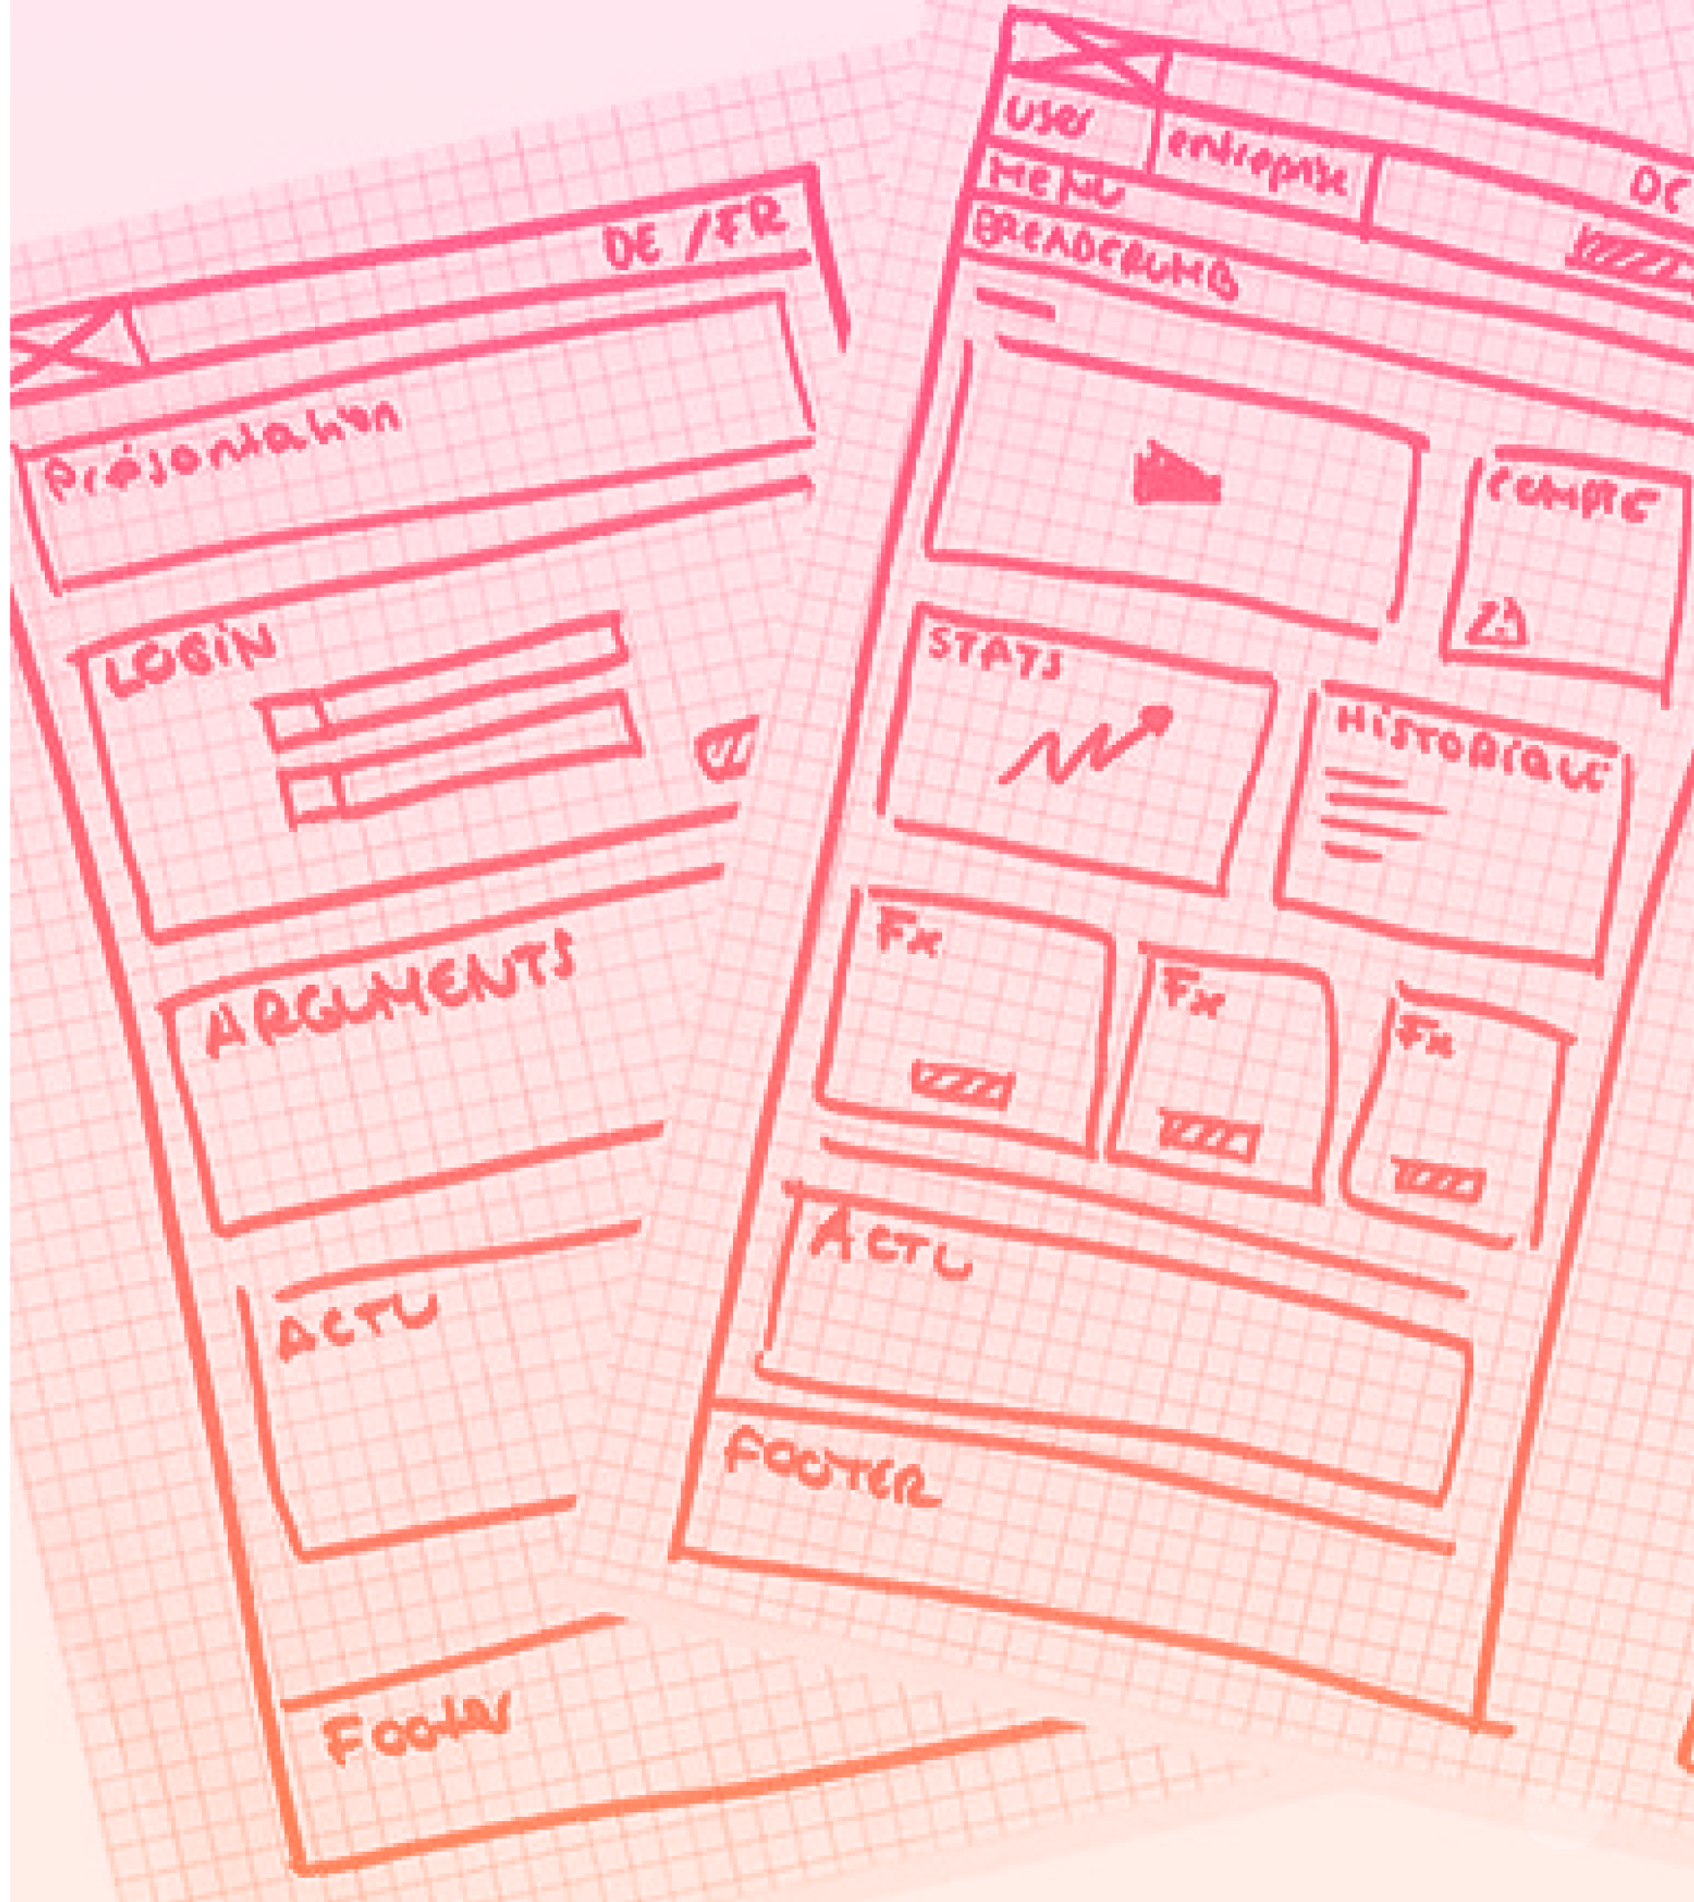
Zoning
Spatial schematization of the interface
Focus: order of elements, occupation of format, structure
Reco. tools: paper, board, post-it
Interaction: static

Slide 52
Zoning
Benefits
Disadvantages
Economical ++ Fast ++ (preparation / creation / modification) Designer more inclined to change ++ Character in progress acquired for stakeholders
Ideal for co-design
Not sufficient in itself Discussions still rely heavily on imagination Feedback not always integrable / realistic Be comfortable with a pencil

Slide 53
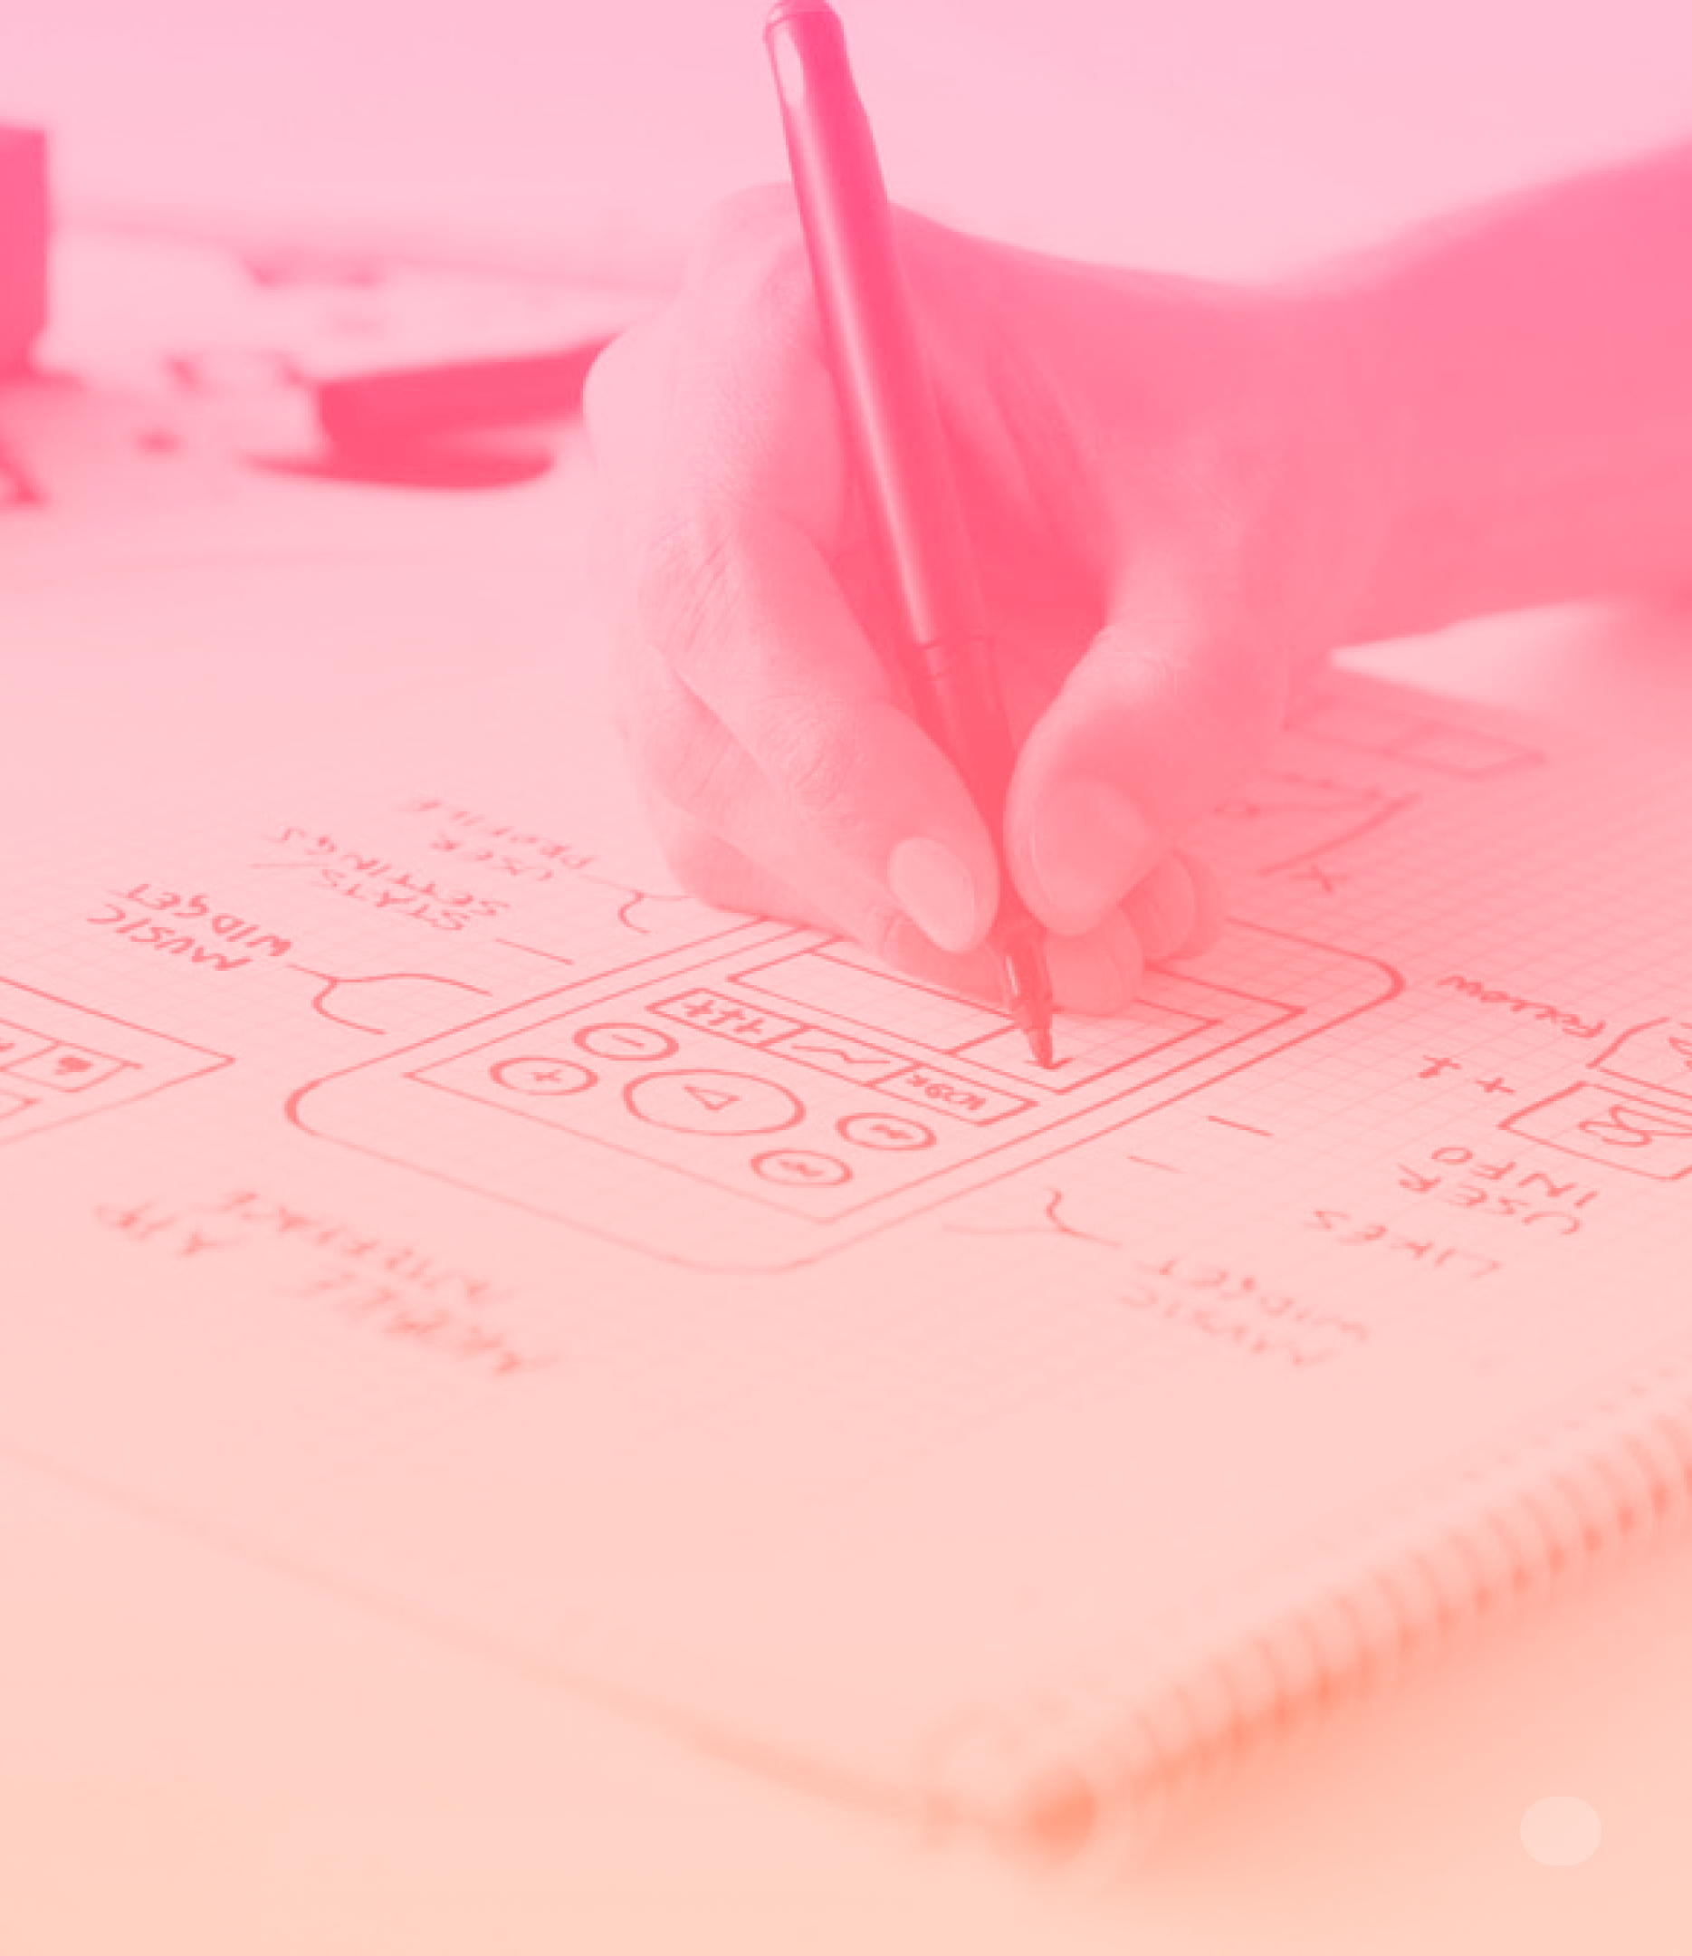
Low-fi wireframe
Black & white model taking into account the functional scope.
Focus: role of zones, proportions, hierarchy visual, quantity of content, completeness
Reco. tools: paper, wireframing software
Interaction: static or sequential

Slide 54
Low-fi wireframe
Benefits
Disadvantages
Economical + Fast + (edit) Less pressure on testers Designer more inclined to change +
Feedback not always integrable / realistic Stakeholders may think this is a final deliverable Important Testing Presentation ++

Slide 55
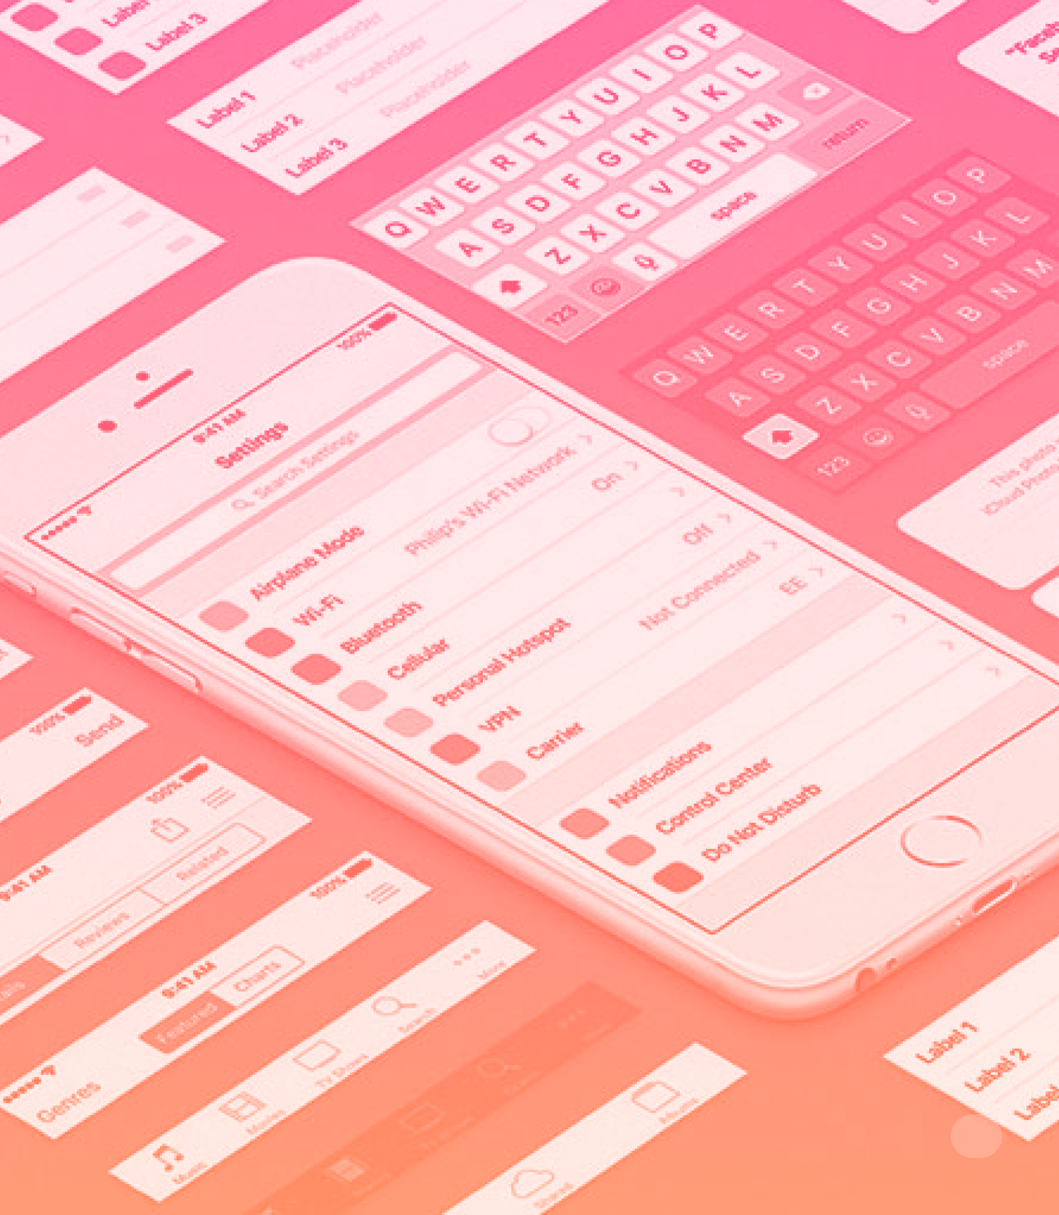
Low-fi wireframe
Detailed model very close to the rendering final visual.
Focus: understanding of the content, brand fit, hierarchy visual
Reco. tools: wireframing software
Interaction: static or sequential or animated

Slide 56
High-fi wireframe
Benefits
Disadvantages
Reliable results + Flow Integration + More realistic tester behavior Refining phase: no worries about the realization for the designer
Designer not inclined to modification Preparation of testing material + Approximate simulation of interactions Important Testing Presentation +

Slide 57

Interactive prototyping
Model more or less close to the rendering final visual and functional.
Focus: understanding flow, interactions, affordance, validation of scenarios
Reco. tools: prototyping software, HTML
Interaction: sequential and/or animated

Slide 58
Interactive prototyping
Benefits
Disadvantages
Reliable results + Light testing contextualization (if High-Fidelity) + Refining phase: no worries about the realization for the designer
Designer not inclined to modification Need resources (Dev) to simulate interactions if we want to go further Risk of bug Presentation/validation of important testing +

Slide 59
What ? When ?
Take into account
The subject to be tested
The work context
His personal skills
His personal preferences
Take into acccount
Lo-Fidelity Interactive : Crucial and inexpensive step.
Interactive High-Fidelity : Essential on large-scale projects before any development
Note: It is not mandatory to combine all types of prototypes on the same project.

Slide 60
Practice
Go to figma file and practice in Figma
Notes:
pages Figma, base, option, type of interactions => demonstration of the basics in Figma then
page Exercise 1 : Tell us a story using shapes only (please) => manipulation of basic shapes in Figma to create a story to present
pages overlays => demonstration then
page Exercise 2 : create something (a screen) with overlays
pages interactive components, variables => demonstration then
page Exercise 3 : we just ask you to create links for a prototype

Slide 61
RESSOURCES
Wise
Liferay
GEL - Westpac group
Branding with a focus on accessibility and articles from the design team
Also contains articles from the design team
A DS that encompasses several brands
Luna
OpenBridge
Wanda
Another DS that encompasses several brands. Possibility to change theme (brand) live
DS specific to maritime interfaces
Wonderflow.ai DS

Slide 62
RESSOURCES
Similar layer
Styler
Batch Styler
Select layers based on common criteria
Create, detach, apply styles in groups
Modify styles in one go (change color, font, etc.)
Typescales
Tailwind color generator
Design lint
Generate text scales based on a few inputs
Generate color palettes based on a base color
Define and verify rules that designs must respect

Slide 63
RESSOURCES
Self documentation
EightShapes Specs
Propstar
Generate documentation components automatically
Create specs automatically based on instances
Generate and show all possible variants of a component

Slide 64
RESSOURCES
Design Systems
The component gallery
Luis (Figma)
Articles, best practices and list of open design systems
List of components and how some DS handle them
Tweets often about DS, best practices, organization, ...
Molly Hellmuth
Design System Checklist
DS List
“Teaching what I know about Figma & Design Systems“
Checklist of tasks for creating a design system
List created by Vitaly Friedman of design systems by country

Slide 65
RESSOURCES
Design System ROI Calculator
Building a Cross-Platform DS
A tool to calculate the returns on investment that a DS can bring
How Booking built its multi-platform DS (Design language, tokens, “design API” ...)

Slide 66
ADDITIONAL READING
https://www.designsystems.com/
Atomic Design by Brad Frost https://bradfrost.com/blog/post/atomic-web-design/
https://www.figma.com/best-practices/branching-in-figma/
https://help.figma.com/hc/en-us/articles/360039820134-Manage-and-share-styles#Move_styles

